Slide 1
BAD CRISIS MANAGEMENT MEANS WAR
How President George W. Bush Constructed Americans’ Collective Memory of September 11th through the Media

Slide 2
Overview
Summary
Sept. 11, 2001
Collective Memory
Bush Administration Responses
Media Relations & Coverage
Better Crisis Management Strategy

Slide 3
Summary
September 11, 2001 began as an ordinary fall day in the United States. Not until about 8:50 that morning did a plane hit the north tower of the World Trade Center, launching terrorist attacks that would mark world history. With numerous media sources informing the public of the current state of the nation and capturing every moment as events continued to unfold our societal collective memory of September 11th was constituted by the press coverage and actions of the Bush Administration. This case study analyzes President George W. Bush and Administration’s handling of the situation and their crisis communication response.

Slide 4
What is Crisis Management?
PR practice of responding to (or preventing) crises/issues/accidents
Key: Seriously to consider timing and message framing and distribution when responding to or preventing crises

Slide 5
When Responding To A Crisis
1) Begin early and initiate a dialogue. Do not wait until the opposition marshals its forces. Early contact with anyone who may be concerned or affected is vital to establishing trust.
2) Actively solicit and identify concerns. Informal discussions, surveys, interviews, and focus groups are effective in evaluating issues and identifying outrage factors.
3) Recognize the public as a legitimate partner in the process. Engage interested groups in two-way communication and involve key opinion leaders.
Wilcox, D. H. , G. Cameron, B. H. Reber, and J. Shin. Think public relations. 2nd ed. New York: Allyn & Bacon, 2010. print.

Slide 6
(cont.)
4) Address issues of concern, even if they do not directly pertain to the situation.
5) Anticipate and prepare for hostility. To defuse a situation, use a conflict resolution approach. Identify areas of agreement and work toward common ground.
6) Understand the needs of the news media. Provide accurate, timely information and respond promptly to requests, and
7) Always be honest, even when it hurts.
Wilcox, D. H. , G. Cameron, B. H. Reber, and J. Shin. Think public relations. 2nd ed. New York: Allyn & Bacon, 2010. print.

Slide 7
More To Consider
It is important to be honest, apologize, be prepared and show corrective actions. And do not attack accusers, deny, excuse, justify, or claim simple ignorance to malpractices and errors.

Slide 8
What Do We Remember About 9/11?
Four-coordinated suicide attacks on US
New York City and the Washington, D.C. areas.
19 terrorists from the Islamist militant group Al Qaeda hijacked four passenger jets
Crashed two planes into the Twin Towers of the World Trade Center in New York City

Slide 9
(cont.)
Hijackers crashed a third passenger jet into the Pentagon in Arlington, Virginia
Fourth jet crashed into a field near Shanksville, Pennsylvania
Nearly 3,000 Americans died

Slide 10
Collective Memory
“…Collective memory helps people use the past to give meaning to the present and to exercise full spread of power across time and space…collective memory reflects a group’s codified knowledge over time about what is important, preferred, and appropriate.”
Zelizer, Barbie. Covering the Body: the Kennedy Assassination, the Media, and the Shaping of Collective Memory. Chicago: University of Chicago, 1992. Print.

Slide 11
Bush Admin. Response
“In these acts and many others, Americans showed a deep commitment to one another and in an abiding love for our country. Today, we feel what Franklin Roosevelt called, "the warm courage of national unity." This is a unity of every faith and every background. This has joined together political parties and both houses of Congress. It is evident in services of prayer and candlelight vigils and American flags, which are displayed in pride and waved in defiance. Our unity is a kinship of grief and a steadfast resolve to prevail against our enemies. And this unity against terror is now extending across the world...”
McClellan, Scott. What Happened: Inside the Bush White House and Washington's Culture of Deception. New York: Public Affairs, U.S, 2008. Print.

Slide 12
(cont.)
“Today we’ve had a national tragedy. Two airplanes have crashed into the World Trade Center in an apparent terrorist attack on our country. I have… ordered that the full resources of the federal government go to help the victims and their families, and to conduct a full-scale investigation to hunt down and to find those folks who committed this act. Terrorism against our nation will not stand…”
Mills-Knutsen, Joshua. "Desire For Destruction: The Rhetoric Of Evil And Apocalyptic Violence." At The Interface / Probing The Boundaries 63.(2011): 287-299. Communication & Mass Media Complete. Web. 7 Dec. 2011.

Slide 13
Media Relations & Coverage
Messages of the Terror War rang all over broadcast radios stations and collaged newspapers, magazines, and televisions worldwide
Television was at the forefront of all mediums

Slide 14
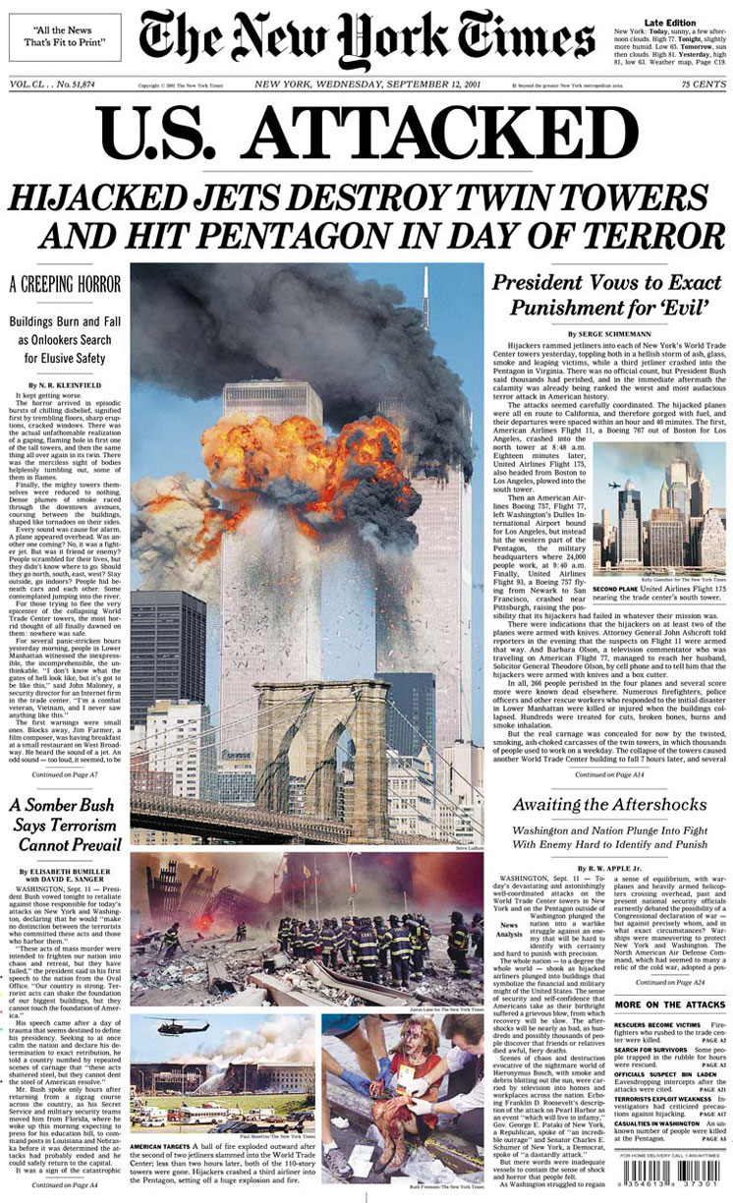
(cont.)

Slide 15
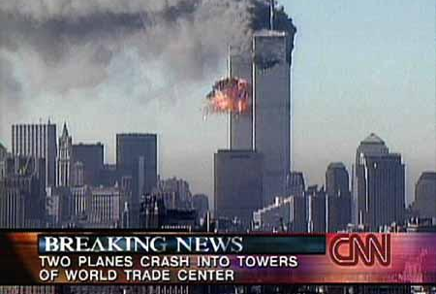
(cont.)

Slide 16
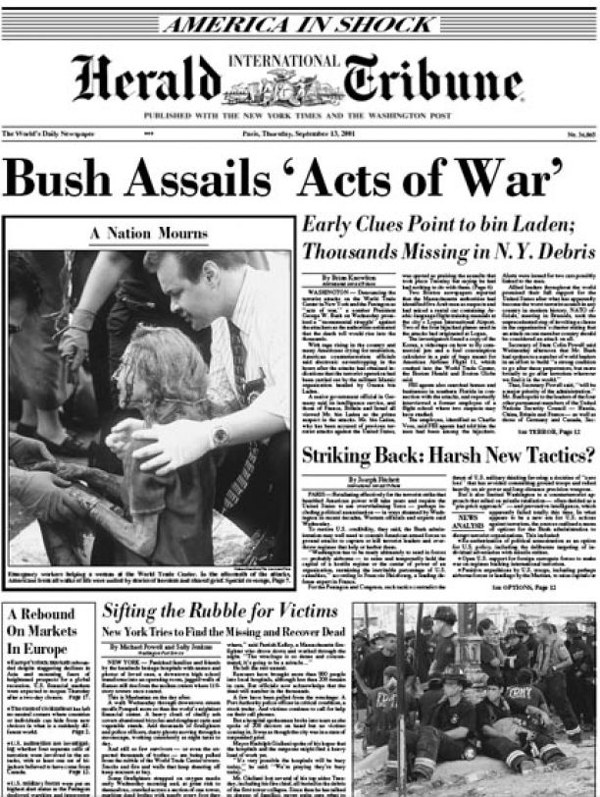
(cont.)

Slide 17
Better Crisis Management Strategy
International Communication Association study
Had the Bush Administration had more time to react to the spontaneity of the September 11th attacks, they would have been able to gain more support of their consequential decisions on handling the situation.

Slide 18
(cont.)
Based on your knowledge how would you have responded to 9/11 crisis?

